Slide 1

The Minimal is the Message Minimalism McLuhan Mashup

Slide 2
https://youtu.be/OQSNhk5ICTI double rainbow
Judd Rainbow https://vimeo.com/14081289
https://youtu.be/HeDnPP6ntic?t=164 global village (just watch a bit of this) 2:45 mcluhan begins
https://youtu.be/ijeMM-NXvus?t=176 mcluhan ads/internet
http://www.youtube.com/watch?v=B0HQVam4T0k&feature=related right hand
page reader
http://www.youtube.com/watch?v=OAgHWj0sQAo&feature=related videodrome
trailer (this is a movie sort of about mchluhan)
http://www.youtube.com/watch?v=qul-rDvU9QI videodrome interview brian oblivian
http://www.youtube.com/watch?v=H5cLj6L6zvo&feature=related videodrome brian oblivion
Are videogames only about games or can they be about the experiential modes produced by the technologies involved? In other words, if we are to study the meaning of all that are bound up in the phenomena that we know when we say “videogames” can we do so without focusing on their “gameness” rather than their visual, auditory, spatial, social, ontological characteristics?

Slide 3


Slide 4


Slide 5


Slide 6
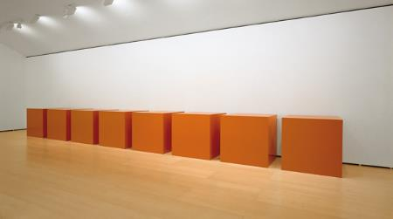

Slide 7
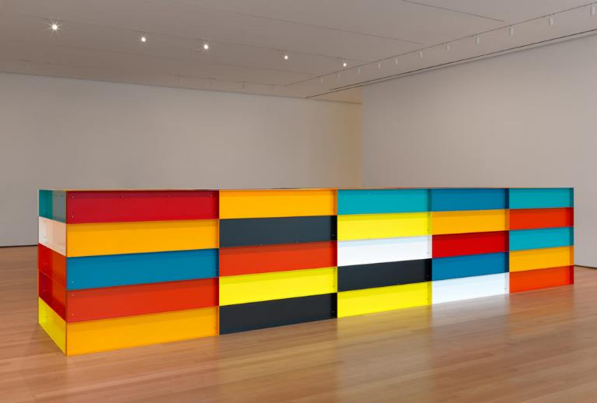

Slide 8


Slide 9


Slide 10


Slide 11


Slide 12


Slide 13


Slide 14


Slide 15
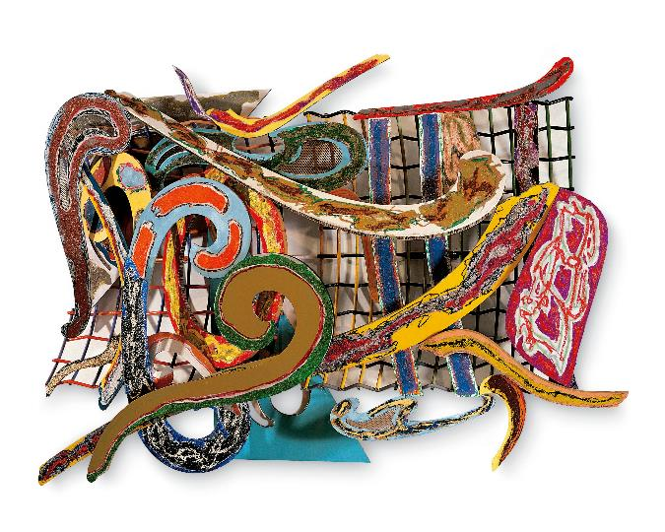

Slide 16


Slide 17
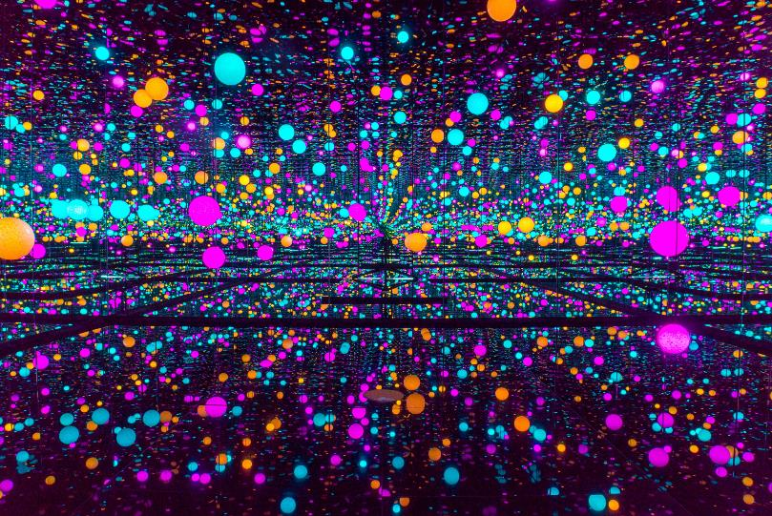

Slide 18
Mirror Mirror:
Reflections on Virtual Reality
Where do we best situate the development of virtual reality as a cultural form? Will its future development be along the lines of the evolution of cinema, video games, models, or some hybrid of these antecedents?

Slide 19
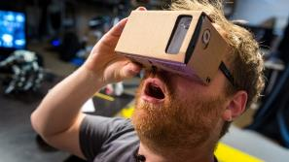
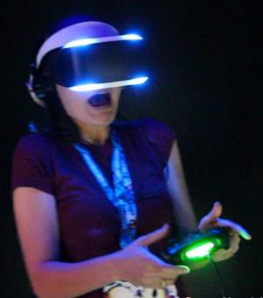
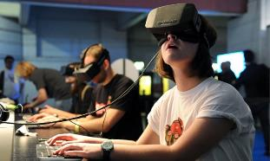
New devices promising high quality at low cost have ignited renewed interest in virtual reality.

Slide 20

Is Virtual Reality an important media form for the 21st Century?
What is Virtual Reality?
Computer mediated environment created from 3D texture mapped geometry, articulated by a users interactivity with HCI devices which are generally designed to interact with bodies in more sensory filling ways then we typically use when interacting with media – creating a sense of “Immersion” with the mediated representation.
Utilizing mediation for activities that one would typically engage in without mediation.
What does immersion mean? How important is it?

Slide 21

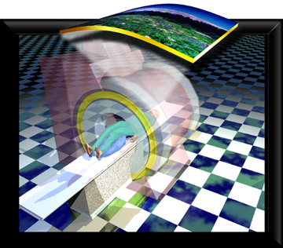
My definition of “immersion”:
Immersion describes a cultural condition –an anxiety about what is real, and its corollaries of what is true and who we are.

Slide 22

Operational Components of Immersion
Direct Address of Viewer/Reader/Audience such that the viewers experience becomes subject of the medium
Multi-Modal extended sensory engagement, i.e. wide angle vision, stereography, haptic interfaces, etc..
Illusion
Immersion requires overcoming a threshold level of choreographed cultural engagements that transcend their usual situatedness within a non-mediated context.

Slide 23

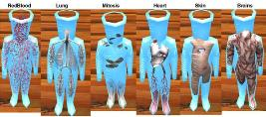
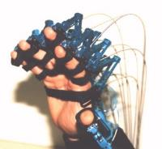
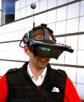
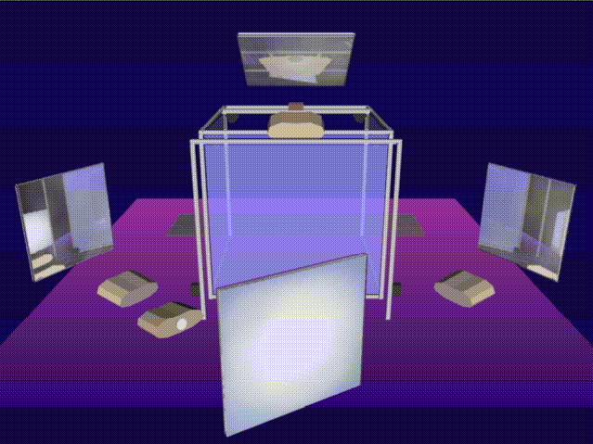
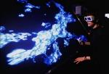
Virtual Reality as a Medium of Immersion
Direct Address of Viewer/Reader/Audience
Avatar embodiment and interactivity as narrative engine
Multi-Modal
Visual, Auditory and Tactile output
Inputs include actuators operated by multiple parts of the body, computer vision systems, environmental sensors along with algorithmic procedures.
Illusion
Perspectival Stereography, coupled to head and vision tracking
Synchronous, multi-plane display

Slide 24
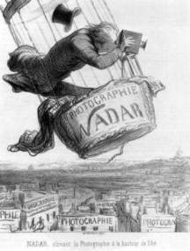

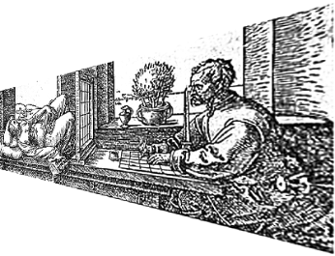
Immersion Antecedents
Immersive forms arise out of the promise and anxiety of cultural transformation

Slide 25
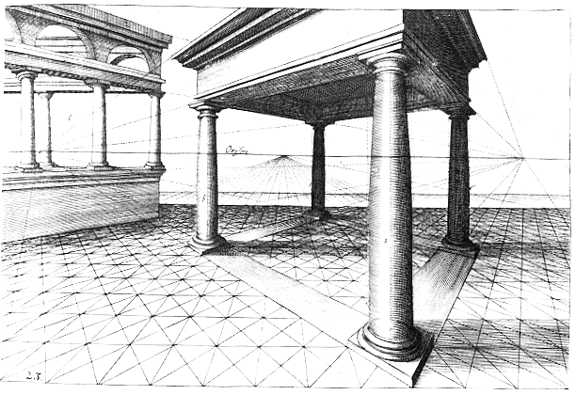
Crises of progress provoked by new tools for vision and knowledge Each time, the new info-surfeit disrupts the status-quo.
Western Culture
15th – 17th Century
Printing
Glass Lenses
Perspective
18th Century
Mass Literacy
Printed illustration
Science, Democracy
19th Century
Mass Education, public libraries
Photography, cinema
Global Connection, closed frontier
20th Century
Computing
Telecommunication
Abstraction
21st Century
Visualization – a rubric for how meaning is created
Gaming – a new cinematic, synthesizing form
Crisis: Religious Upheaval (e.g. 30 Years War)
Quandary: Renaissance vs. Rigid Doctrine
Crisis: Bourgeois Revolution
Quandary: Enlightenment vs. old hierarchies
Crisis: Nationalism-Colonialism-suffrage
Quandary: Industrialism vs. Nostalgia
Crisis: Dogmatic ideologies
Quandary: Modernism vs. Subjectivism
Crisis: Breakdown in coherency/confidence
Quandary: Moore’s Law vs. Discordance
Quandary: Future vs. Past
Despite crises, we never refuse new tools/prosthetics

Slide 26
Immersive forms pop up in many previous mediums, utilizing and provoking the technologies of representation of their moment to see the world in a new way.
Arising from both the cultures interest in the spectacle of new technologies and by the essential need to reframe the relationships between self and world that are profoundly transformed at these moments.

Slide 27
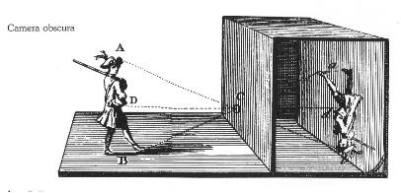
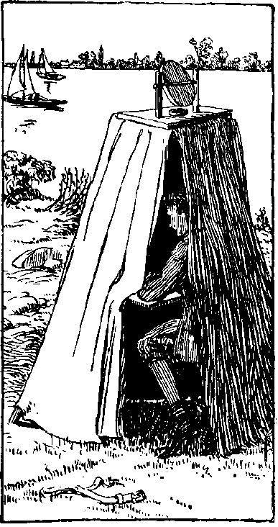
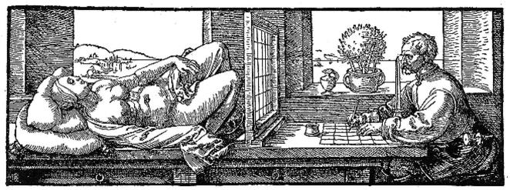
Perception and Immersion
- Vision Technologies and display spectacle
Provided impetus for the development of perspective as seen in both Alberti and Durer, and later on for the development of photography – both conceptually and technologically.

Slide 28
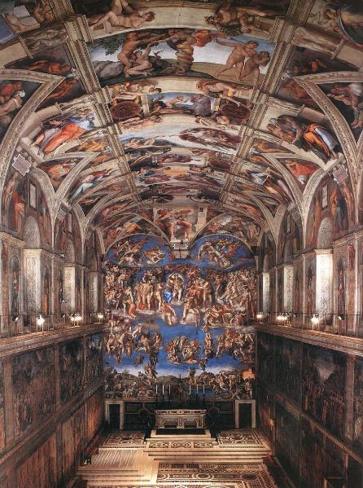

Slide 29
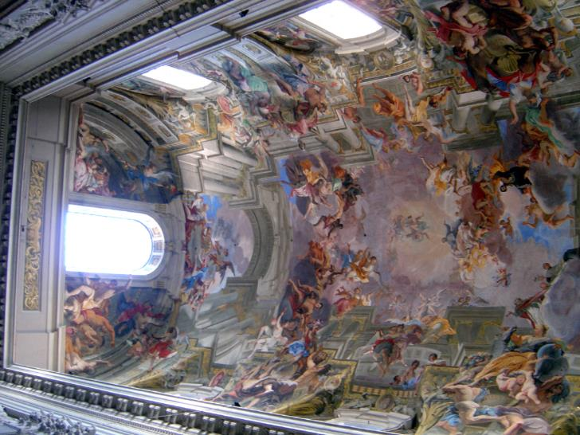

Slide 30
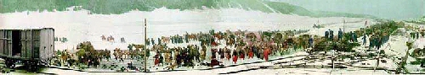
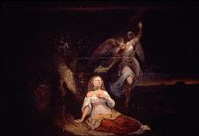
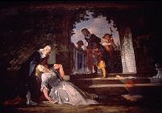
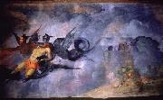
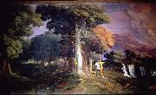
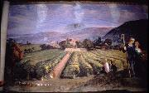
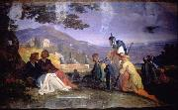
Vision Technologies and display spectacle
Panoramic painting from the mid 19th century – both still and moving through metal tracks via hand cranks. The unrolled pictures creating a "motion picture“, accompanied by piano music and narration.
In 1851, John Bunyan's seventeenth-century Christian allegory Pilgrim's Progress

Slide 31

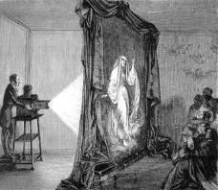

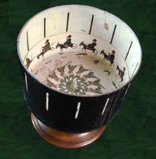
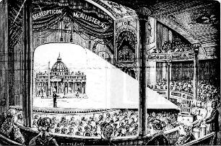

Vision Technologies and display spectacle

Slide 32
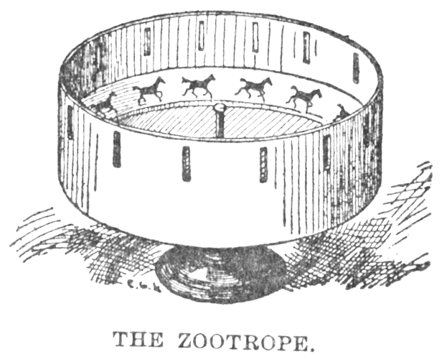
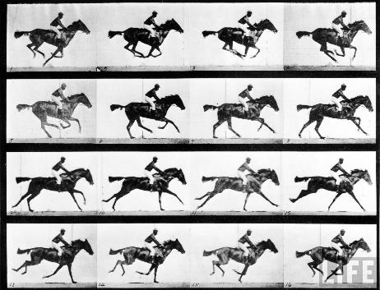
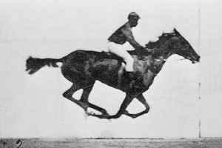

Slide 33


Slide 34
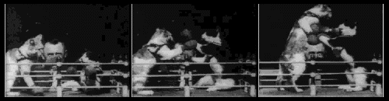
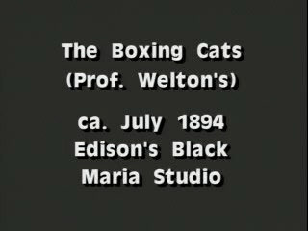

Slide 35

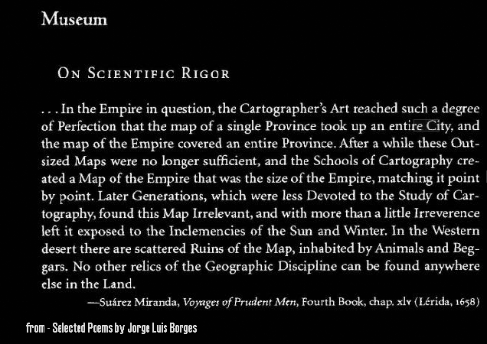
Simulation and Immersion

Slide 36

Immersion is an expression of a desire for transcendence.
This desire comes from, and further spurs on, innovation in looking for modes of achieving the transformative possibilities of the moment.
This creates an initial, eclectic diversity of forms, which have tended to coalesce around specific implementations which show themselves to have a wide expressive range, and become monolithic mediums – will this be the case in the 21st century?

Slide 37
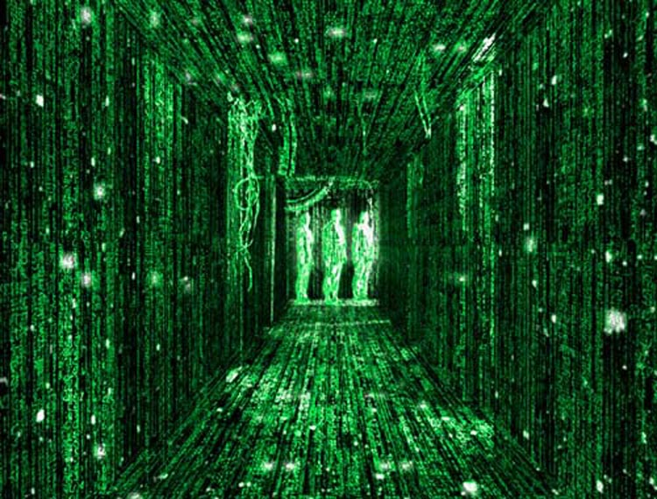
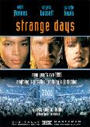

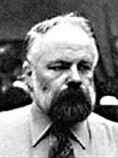
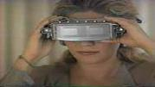


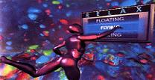


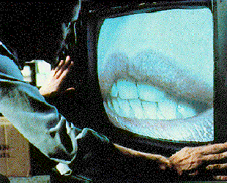
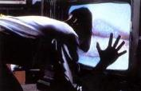
Popular Culture Speculations
Films in the 80’s and 90’s based on Science Fiction of the 60’s and 70’s
Until the End of the World
by Wim Wenders.1991
The Lawnmower Man
directed by Brett Leonard
written by Stephen King. 1992
1995
1990
1993
1997
1999
1983

Slide 38

Narrative Recursion
(Another take on the Big Map)
In the first volume of The World and Individual (1899), the philosopher Josiah Royce creates the following representation:
…. Let us suppose, if you please, that a portion of the surface of England is very perfectly leveled and smoothed, and is then devoted to the production of our precise map of England…. But now suppose that this our resemblance is to be made absolutely exact, in the sense previously defined,.. A map of England, contained within England, is to represent, down to the minutest detail, every contour and marking, natural or artificial, that occurs upon the surface of England… For the map, in order to be complete, according to the rule given, will have to contain as a part of itself, a representation of its own contour and contents. In order that this representation should be constructed, the representation itself will have to contain once more, as a a part of itself, a representation of its own contour and contents; and this representation, in order to be exact will have once more to contain an image of itself; and so on without limit.

Slide 39

Narrative Recursion
Fusing the world of the reader and the world of the book
Hamlet watches the play of Hamlet
In 1001 Nights, night 602 consists of the telling of the story of 1001 nights
Don Quixote becomes a reader of Don Quixote
Borges responds – Why does it make us uneasy to know that the map is within the map and the thousand and one nights are within The 1001 Nights? Why does it disquiet us to know that Don Quixote is a reader of the Quixote, and Hamlet is a spectator of Hamlet? I believe I have found the answer: those inversions suggest that if the characters in a story can be readers of spectators, then we, their readers or spectators, can be fictitious.

Slide 40
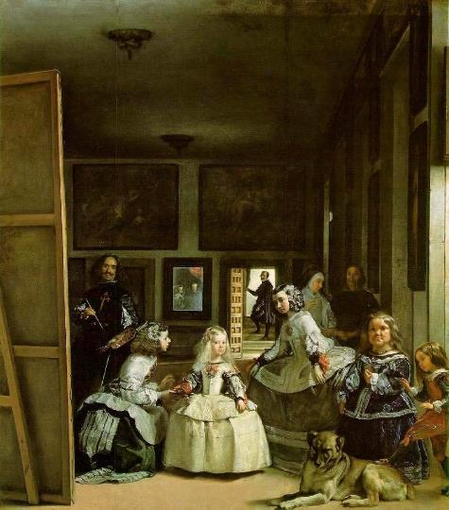

Slide 41
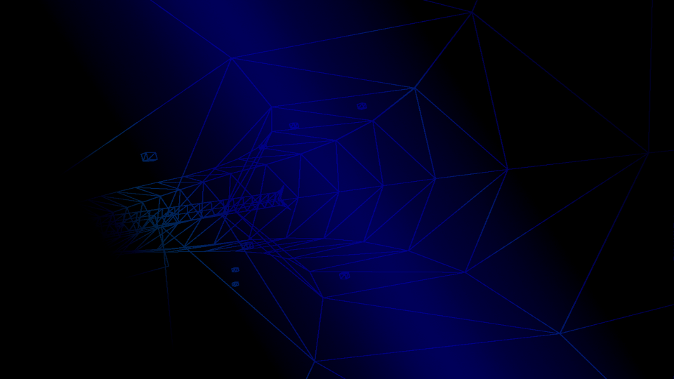
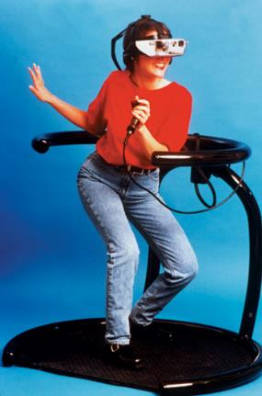
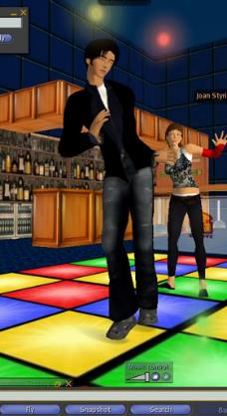
Typecasting Virtual Experience

Slide 42

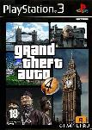
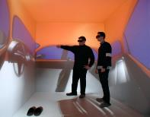



3D computer graphic forms have coalesced into several distinct areas.
Computer games, virtual reality, virtual worlds, scientific visualization, simulation and 3D cinema, each evoke a different set of suppositions and expectations.

Slide 43






SAGE and Whirlwind projects US military R&D create air defense system
Ivan Sutherland’s 3D Sketchpad 1963
New HCI devices created by Sutherland (HMD), Engelbart’s mouse
algorithms developed in the 1970's for raster graphics displace vector graphics
Bell Labs, Lawrence Livermore and Boeing Aircraft computer animated films of satellite orbits, fluid flows and aircraft vibration in early 1960's.

Slide 44

These differences include aspects such as:
The nature of time Event construction
Visual Aesthetics HCI
Types of Interactions Experiential Outcomes
3D computer graphics form the underlying representational schema, with similar relationships between the self, the world, its representation and the other.

Slide 45






Each type privileges an experiential niche
games and structured activity
virtual worlds and socialization
simulation and measured outcomes
virtual reality and sensory fusion
scientific visualization and process
cinema and narrative

Slide 46

If a new “medium” emerges from this state, will it be a synthesis of all of these characteristics? Is the concept of a “medium” still viable with such a technologically unstable form?

